Slide 1
Python
OOP
Object oriented

Slide 2
Class
Method - A special kind of function that is defined in a class definition.
Objects - A unique instance of a data structure that's defined by its class. An object comprises both data members (class variables and instance variables) and methods.

Slide 3
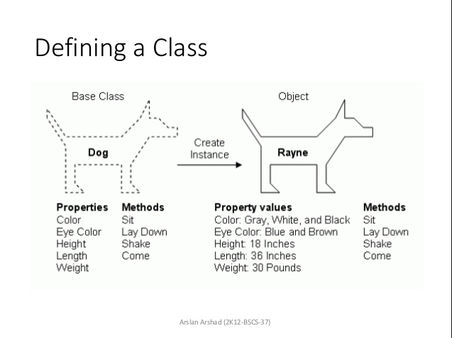

Slide 4
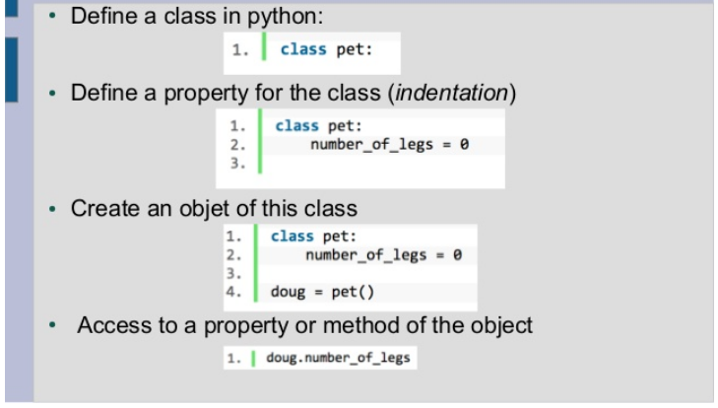

Slide 5
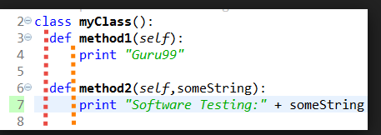

Slide 6
Creating Classes
The class statement creates a new class definition
class Employee:
The class has a documentation string, which c
an be accessed via ClassName.__doc__.
The class_suite consists of all the component statements defining class members, data attributes and functions.

Slide 7
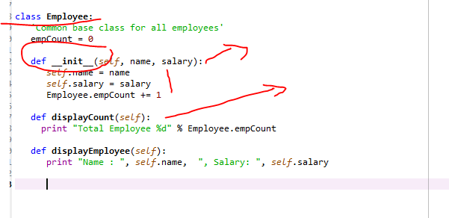

Slide 8
Class Employee:
def _ _init_ _(self, name, salary):
variable empCount is a class variable whose value is shared among all instances of a this class

Slide 9
first method __init__() is a special method, which is called class constructor or initialization method that Python calls when you create a new instance of this class.
You declare other class methods like normal functions with the exception that the first argument to each method is self.

Slide 10
Employee.py
class Employee:
'Common base class for all employees'
empCount = 0
def __init__(self, name, salary):
self.name = name
self.salary = salary
Employee.empCount += 1
def displayCount(self):
print( "Total Employee %d" % Employee.empCount)
def displayEmployee(self):
print("Name : ", self.name, ", Salary: ", self.salary)

Slide 11
To create instances of a class, you call the class using class name and pass in whatever arguments its __init__ method accepts.
emp1 = Employee(“Pavan", 2000)

Slide 12
"This would create first object of Employee class"
emp1 = Employee("pavan", 2000)
"This would create second object of Employee class"
emp2 = Employee("kumar", 5000)
emp1.displayEmployee()
emp2.displayEmployee()
print ("Total Employee %d" % Employee.empCount)

Slide 13
emp2.displayCount()
The getattr(obj, name[, default]) − to access the attribute of object.
The hasattr(obj,name) − to check if an attribute exists or not.
The setattr(obj,name,value) − to set an attribute. If attribute does not exist, then it would be created.
The delattr(obj, name) − to delete an attribute.

Slide 14
Built-In Class Attributes
Every Python class keeps following built-in attributes and they can be accessed using dot operator like any other attribute −
__dict__ − Dictionary containing the class's namespace.
__doc__ − Class documentation string or none, if undefined.
__name__ − Class name.
__module__ − Module name in which the class is defined. This attribute is "__main__" in interactive mode.
__bases__ − A possibly empty tuple containing the base classes, in the order of their occurrence in the base class list.

Slide 15
print "Employee.__name__:", Employee.__name__

Slide 16
Destroying Objects
Destroying Objects (Garbage Collection)
Delete automatically to free the memory space.
def __del__(self):
class_name = self.__class__.__name__
print class_name, "destroyed"

Slide 17
Emp.py
import Employee as Emp
"This would create first object of Employee class"
emp1 = Emp.Employee("pavan", 2000)
"This would create second object of Employee class"
emp2 = Emp.Employee("kumar", 5000)
emp1.displayEmployee()
emp2.displayEmployee()
emp2.displayCount()
print ("Total Employee %d" % Emp.Employee.empCount)

Slide 18
print ("Total Employee %d" % Emp.Employee.empCount)

Slide 19
class MyClass:
myobjectx = MyClass()
#Now the variable “myobjectx” holds an object of the class “MyClass” that contains the variable and the function defined within the class called “MyClass“.
Import classname as cname
print(myobjectx.variable) # Accessing Object Variables
myobjectx.function()

Slide 20
Class vehicle
class Vehicle:
name = ""
kind = "car"
color = ""
value = 100.00
def description(self):
desc_str = "%s is a %s %s worth $%.2f." % (self.name, self.color, self.kind, self.value)
return desc_str
# your code goes here
car1 = Vehicle()
car1.name = "Fer"
car1.color = "red"
car1.kind = "convertible"
car1.value = 60000.00
car2 = Vehicle()
car2.name = "Jump"
car2.color = "blue"
car2.kind = "van"
car2.value = 10000.00
# test code
print(car1.description())
print(car2.description())

Slide 21
The self-argument refers to the object itself. Hence the use of the word self. So inside this method, self will refer to the specific instance of this object that's being operated on.
Notice that when we call the method1 or method2, we don't have to supply the self-keyword. That's automatically handled for us by the Python runtime.

Slide 22
Inheritance
Base Class
Derived
supports multiple inheritances
class DerivedClass(BaseClass):
body_of_derived_class
ParentClass.Method.

Slide 23
Constructors
It begins with a double underscore (_). It __init__() method
class User:
name = ""
def __init__(self, name):
self.name = name
def sayHello(self):
print("Welcome to Guru99, " + self.name)
User1 = User("Alex")
User1.sayHello()

Slide 24
Polymorphism
class Bear(object):
def sound(self):
print( "Groarrr")
class Dog(object):
def sound(self):
print( "Woof woof!")
def makeSound(animalType):
animalType.sound()
bearObj = Bear()
dogObj = Dog()
makeSound(bearObj)
makeSound(dogObj)

Slide 25
class Human:
# Create instance
obj = Human()
# Call the method
obj.sayHello()
# Call the method with a parameter
obj.sayHello('Guido')

Slide 26
overloading
We create a class with one method sayHello(). The first parameter of this method is set to None, this gives us the option to call it with or without a parameter.

Slide 27
you can restrict access to methods and variables.
this can prevent the data from being modified by accident and is known as encapsulation.

Slide 28
Private methods Encapsulation
We create a class Car which has two methods: drive() and updateSoftware(). When a car object is created, it will call the private methods __updateSoftware().
This function cannot be called on the object directly, only from within the class.
Encapsulation prevents from accessing accidentally, but not intentionally.

Slide 29
class Car:
def __init__(self):
self.__updateSoftware()
def drive(self):
print 'driving'
def __updateSoftware(self):
print 'updating software'
redcar = Car()
redcar.drive()
#redcar.__updateSoftware() not accesible from object.

Slide 30
Private variables
A private variable can only be changed within a class method and not outside of the class.
class Car:
__maxspeed = 0
__name = ""
def __init__(self):
self.__maxspeed = 200
self.__name = "Supercar"
def drive(self):
print 'driving. maxspeed ' + str(self.__maxspeed)
redcar = Car()
redcar.drive()
redcar.__maxspeed = 10 # will not change variable because its private
redcar.drive()

Slide 31
The private attributes and methods are not really hidden, they’re renamed adding “_Car” in the beginning of their name. The method can actually be called using redcar._Car__updateSoftware()

Slide 32
If you want to change the value of a private variable, a setter method is used. This is simply a method that sets the value of a private variable.
def setMaxSpeed(self,speed):
self.__maxspeed = speed

Slide 33
class Car:
__maxspeed = 0
__name = ""
def __init__(self):
self.__maxspeed = 200
self.__name = "Supercar"
def drive(self):
print 'driving. maxspeed ' + str(self.__maxspeed)
def setMaxSpeed(self,speed):
self.__maxspeed = speed
redcar = Car()
redcar.drive()
redcar.setMaxSpeed(320)
redcar.drive()

Slide 34
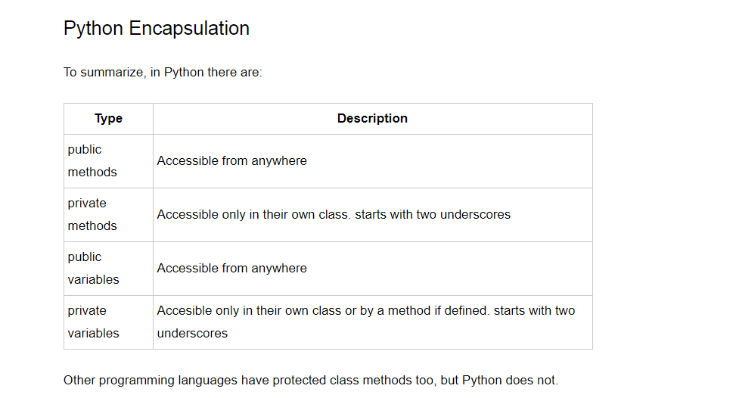

Slide 35
class Animal:
def __init__(self,name):
self.name = name
def walk(self):
print(self.name + ' walks.')
duck = Animal('Duck')
duck.walk()

Slide 36
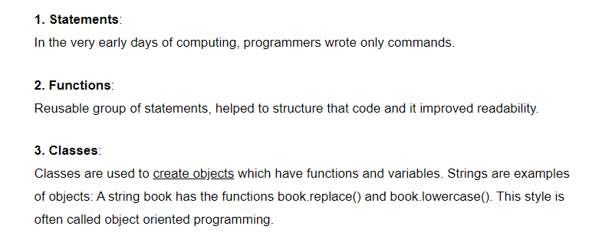

Slide 37
# create virtual objects
james = User("James")
# call methods owned by virtual objects james.sayHello()

Slide 38
Class variables
def addBean(self):
self.beans = self.beans + 1
pythonBean = CoffeeMachine("Python Bean", 83, 20)

Slide 39
Magic Methods
They are special methods with fixed names
So what's magic about the __init__ method? The answer is, you don't have to invoke it directly. The invocation is realized behind the scenes. When you create an instance x of a class A with the statement "x = A()", Python will do the necessary calls to __new__ and __init__.

Slide 40
__call__ method
The __call__ method enables Python programmers to write classes where the instances behave like functions. Both functions and the instances of such classes are called callables
_ _XX_ _
if __name__ == "__main__":

Slide 41
Dunder or magic methods
Dunder or magic methods
Dunder here means “Double Under (Underscores)”
for example __init__
Or
__str__.
__repr__: The “official” string representation of an object. This is how you would make an object of the class. The goal of __repr__ is to be unambiguous.
__str__: The “informal” or nicely printable string representation of an object. This is for the enduser.

Slide 42
Iteration: __len__, __getitem__, __reversed__
Operator Overloading for Comparing Accounts: __eq__, __lt__
dir() # list

Slide 43
Class & Instance Attributes
Class attributes belong to the class itself they will be shared by all the instances. Such attributes are defined in the class body parts usually at the top, for legibility.
class sampleclass:
count = 0 # class attribute
Instance Attributes
Unlike class attributes, instance attributes are not shared by objects. Every object has its own copy of the instance attribute.

Slide 44
To list the attributes of an instance/object, we have two functions:- 1. vars()- This function displays the attribute of an instance in the form of an dictionary. 2. dir()- This function displays more attributes than vars function,as it is not limited to instance. It displays the class attributes as well.

